Slide 1

Toxic Online Comments Analysis
IST 736
Xiangzhen He
Jazmin Logroño
Katherine Hurtado-Da Silva

Slide 2
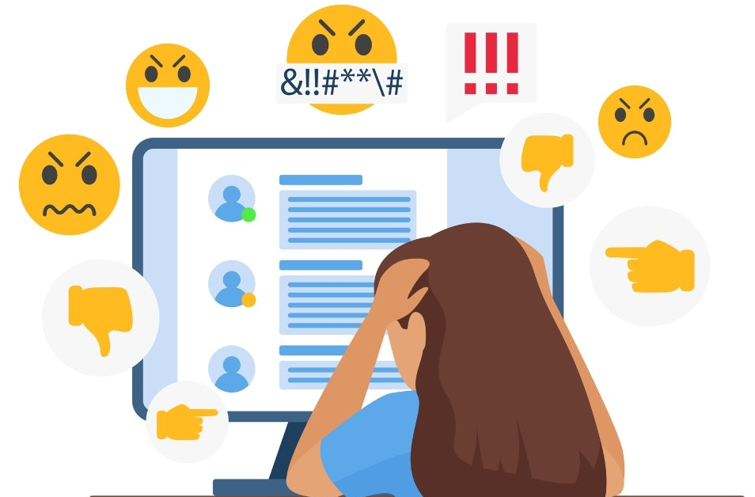
About the Topic
What are toxic comments?
Any comments that are rude and disrespectful
Impacts of toxic comments:
Around 41% of Americans experienced at least one form of online harassment in 2020
Females and individuals from marginalized communities were most affected by online toxicity.
Why does identifying toxic comments matter to individuals and businesses?
Help mediate the exposure and impact they have on internet users.
Help businesses balance free speech and content moderation on their online platforms.

Slide 3
Goal
Use different machine learning algorithms to:
Identify online toxic comments
Identify patterns to detect toxic behaviors
Answer the following questions:
What types of toxicity exist in toxic comments?
Which words contribute to toxic comments?
Are there different levels to toxicity?

Slide 4
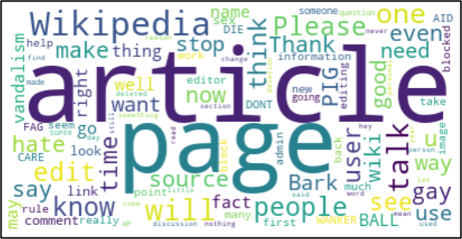
About the Data
Kaggle toxic comment data set that includes user comments from Wikipedia’s talk page edits.
A subset of data that only includes 6,360 non-toxic comments and 6,360 toxic comments were used for the analyses.
The value of a label can be either “0” or “1” indicating non-toxic or toxic comments.
Word Cloud for User Comments

Slide 5
Text Preprocessing
Generally, three types of vectorizers were used in the report
Unigram term frequency vectorizer
N-gram term frequency vectorizer
Tf-idf vectorizer
Basic Vectorization and Tokenization Steps
Stop words were removed using the built-in stop word list for English.
Only keeps tokens that have a document frequency greater or equal to 5
Additional steps including lemmatization and feature reduction were performed for different models

Slide 6
Analysis Methods/Models
Topic Modeling
Naïve Bayes
Clustering
Support Vector Machines

Slide 7
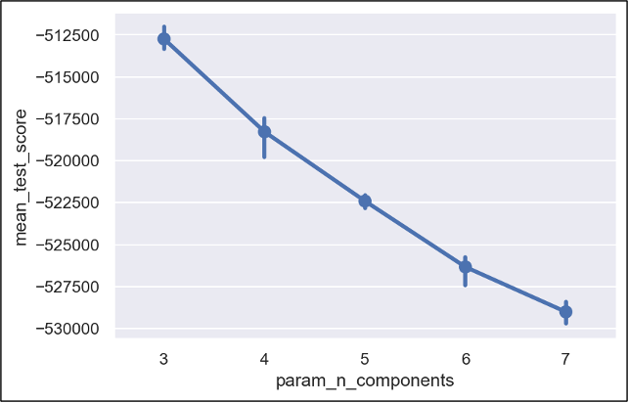
Topic Modeling Using LDA
Important parameters of Latent Dirichlet Allocation (LDA)
Topic Number
Learning method
Learning decay
Best Model after Parameter Tuning
Using vectorizer with lemmatization
Fit data into 3 topics
Learning decay set to 0.8 using online learning method
Model performance when having different number of topics

Slide 8
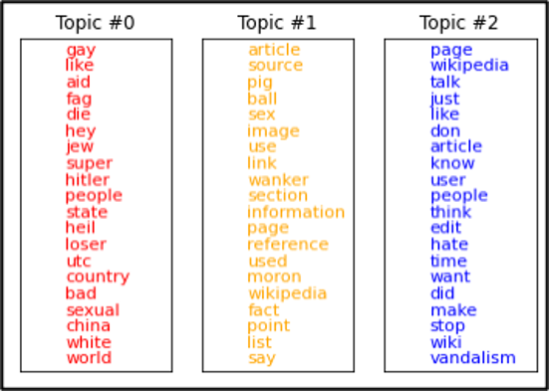
Topic Modeling Using LDA
Use top 15 words found in each topic to define topic meanings
Topic #0: identity hate
Topic #1: insult
Topic #2: non-toxic
Top 15 Words in Each Topic

Slide 9
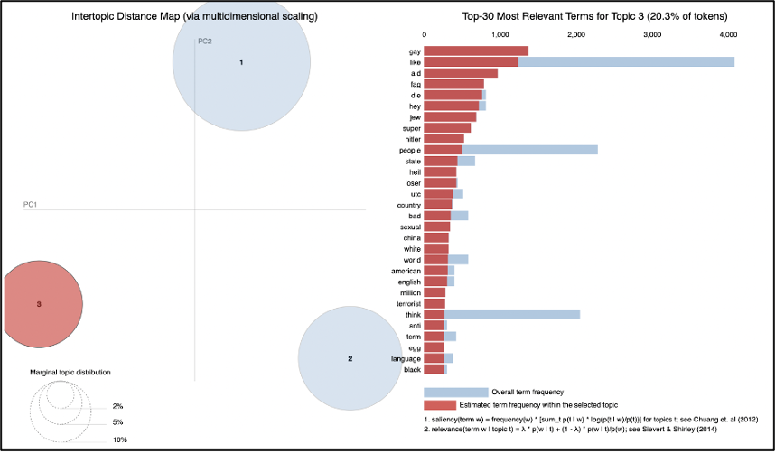
Topic Modeling Using LDA
Intertopic Distance Map shows all three topics are not very similar to each other

Slide 10
Summary of Topic Modeling
Identified non-toxic topic and toxic topics including identity hate and insult.
Topics can also be defined as non-toxic, toxic, and severe toxic based on the words used in each topic that reflect the level and strength of toxicity.

Slide 11
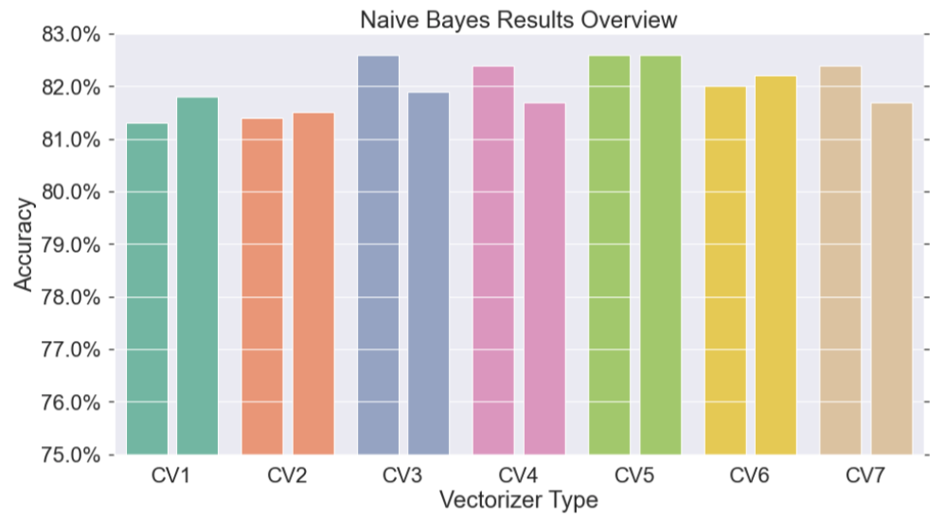
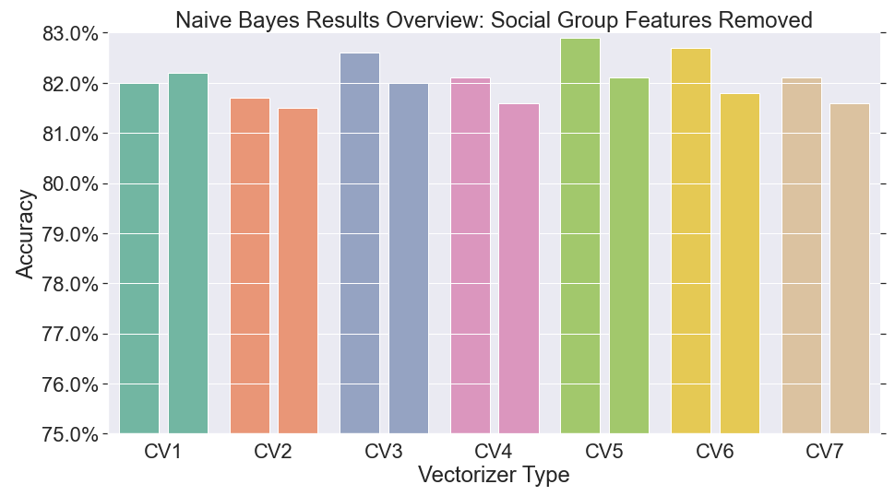
Naïve Bayes
Model had the best predictive performance when comments were vectorized by CV5 (TD-IDF, unigrams, stopwords, lemmatization).
3 of 7 models had slightly lower accuracy levels compared to its cross validated training average.
Model had the best predictive performance when comments were vectorized by CV5 (TD-IDF, unigrams, stopwords, lemmatization).
6 of 7 models had slightly lower accuracy levels compared to its cross validated training average.

Slide 12
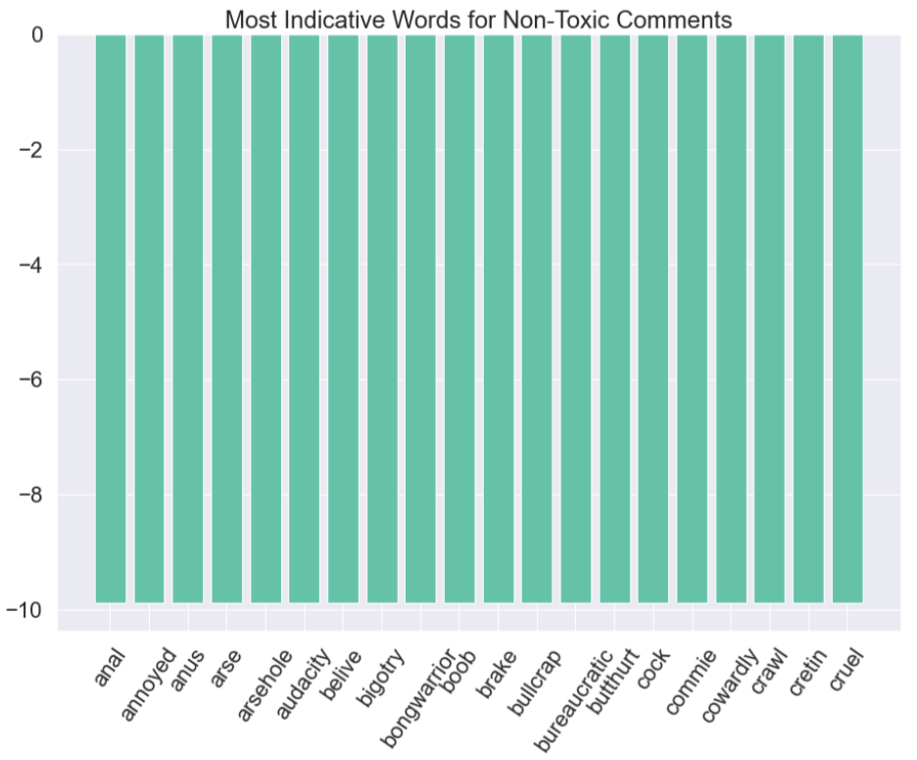
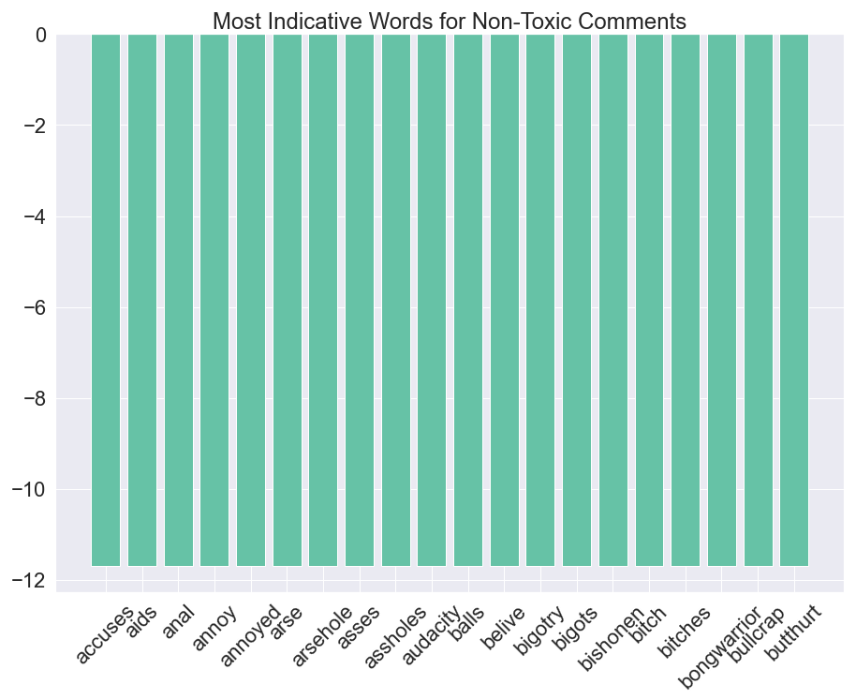
Top 20 Features for Non-toxic Comments
With Features
Without Features
Both top features contain words with negative connotations and vulgar (yet weaker) words.
Removal of features appears to have increased number of vulgar words as top features for non-toxic comments.

Slide 13
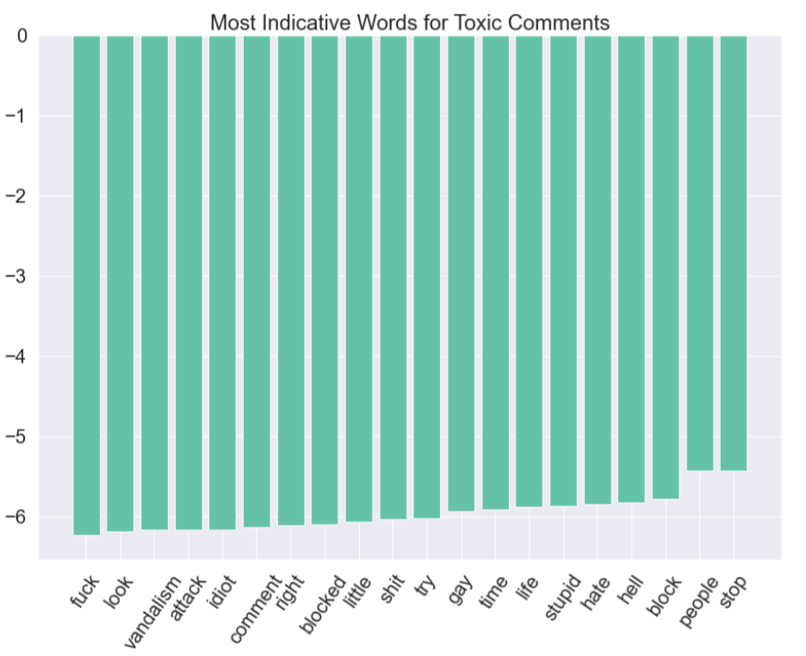
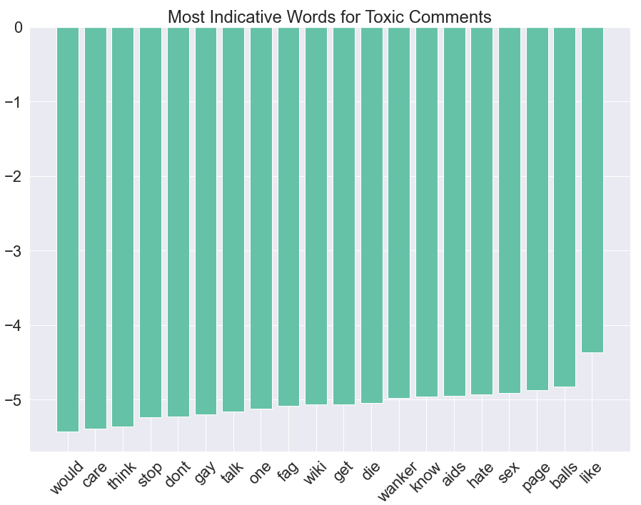
Top 20 Features for Toxic Comments
With Features
Without Features
Top features appear to be defined by stronger swear words.
Both datasets would benefit from removing features like "look" and "would" to improve the quality of indicators for toxicity.

Slide 14
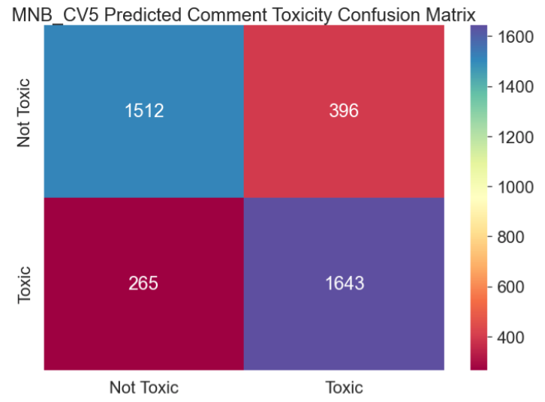
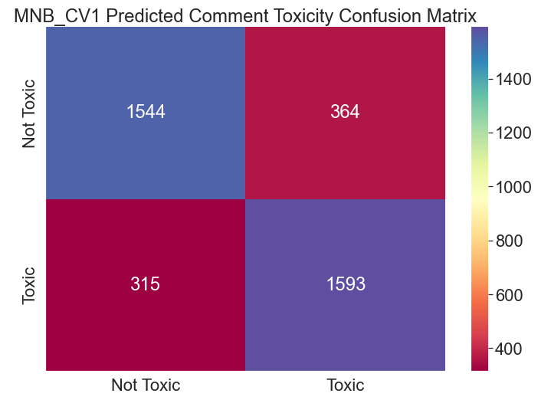
Predictive Performance
With Features
The model with features has a stronger predictive performance for toxic comments
Removal of features also resulted in higher false negative rates
Higher false negative results can translate to the company overlooking toxic content and should be avoided.
Without Features

Slide 15
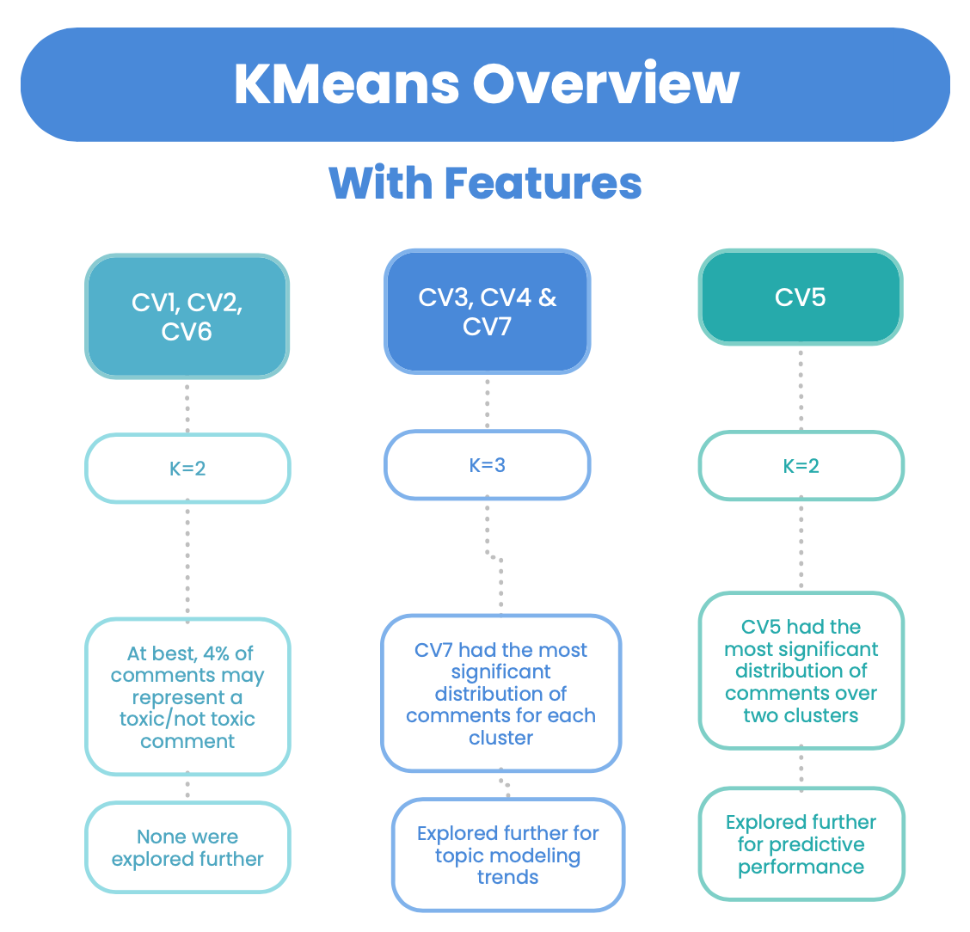
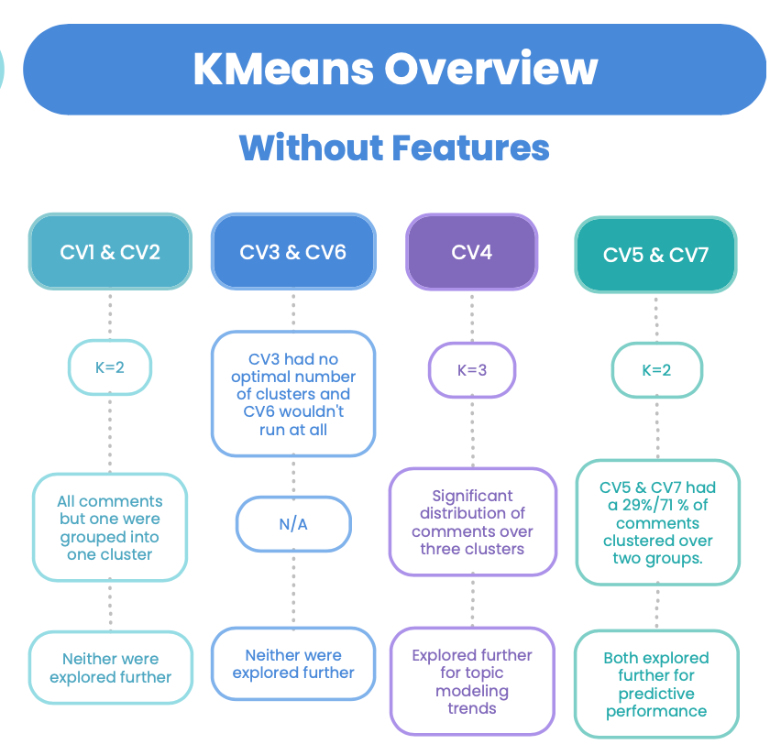
Clustering

Slide 16
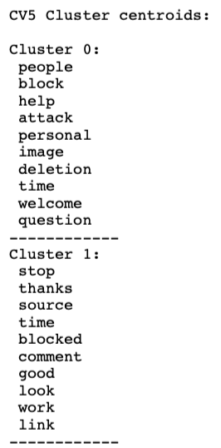
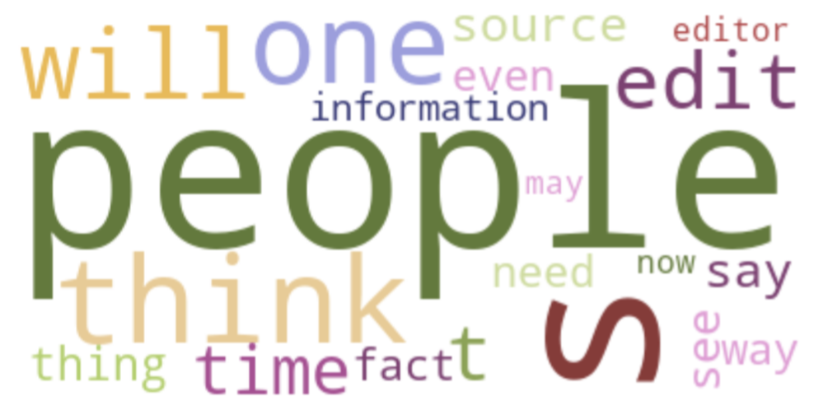
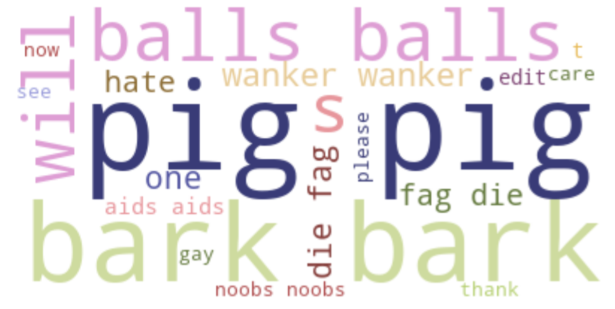
KMeans Model with Features
Model using CV5 vectorizer clustered 49.8% of the comments in the training set correctly
When test set was used, it predicted 50.5% of the unseen data correctly.

Slide 17
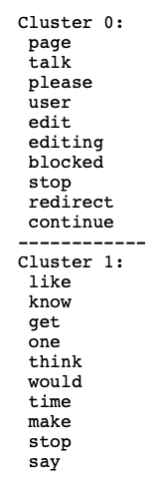
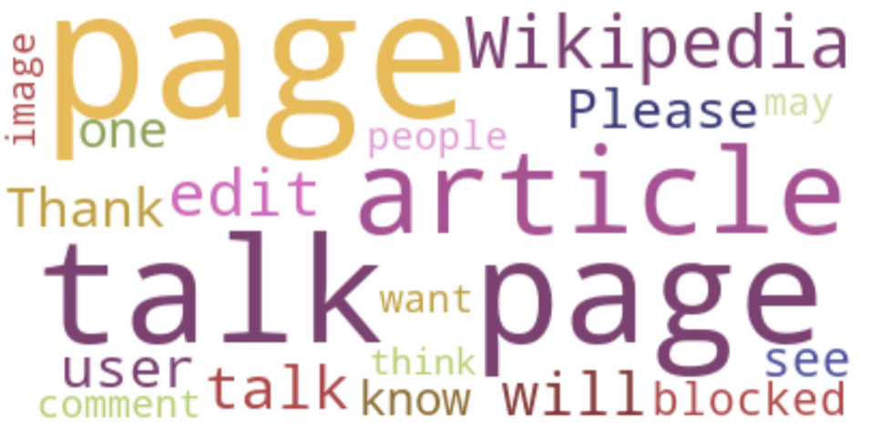
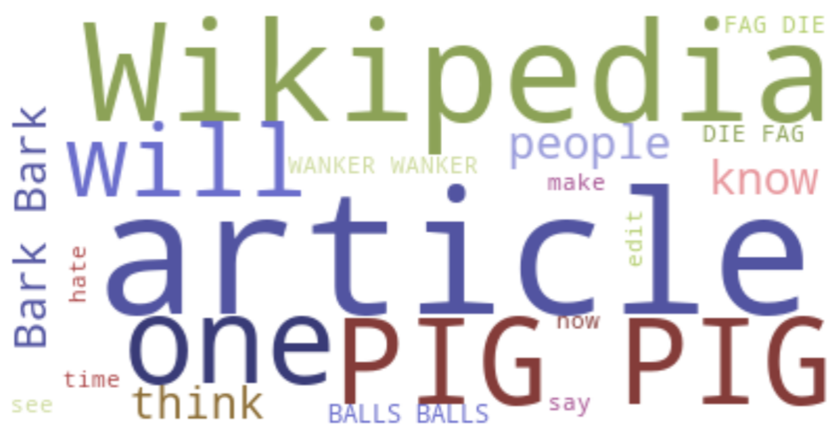
KMeans Model without Features
Model using CV5 vectorizer clustered 55.0% of the comments in the training set correctly
When test set was used, it predicted 55.2% of the unseen data correctly.

Slide 18
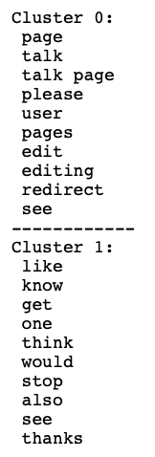
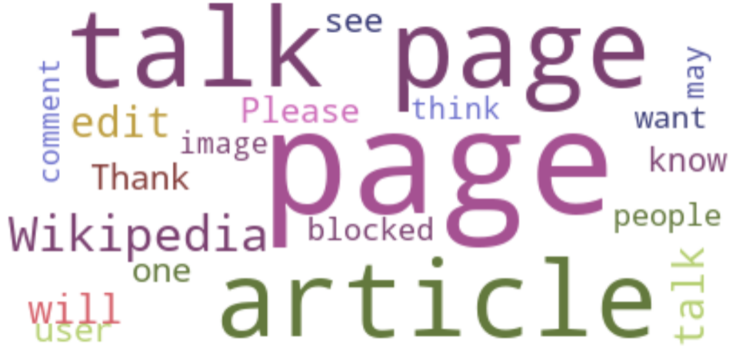
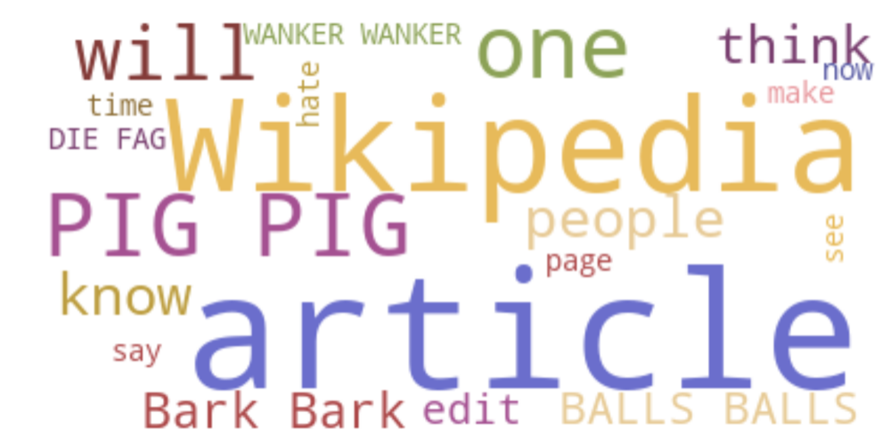
KMeans Model without Features
Model using CV7 vectorizer clustered 55.0% of the comments in the training set correctly
When test set was used, it predicted 55.1% of the unseen data correctly.

Slide 19
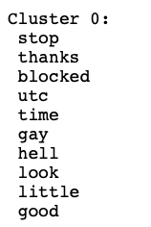
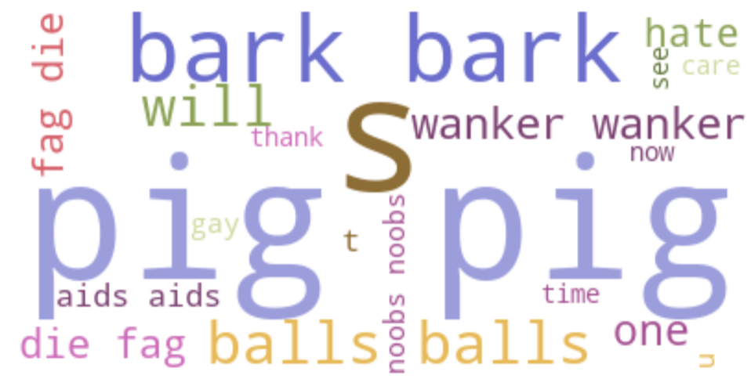
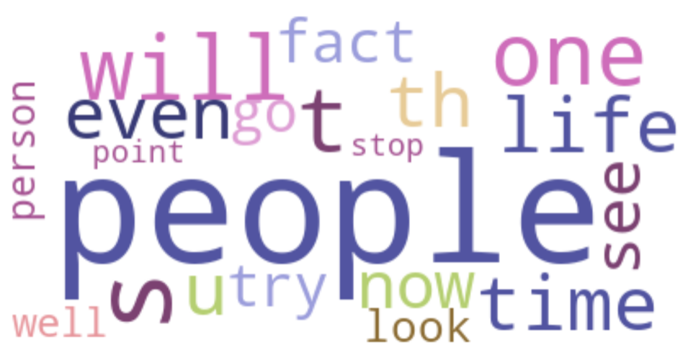
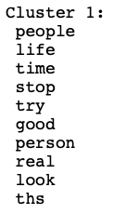
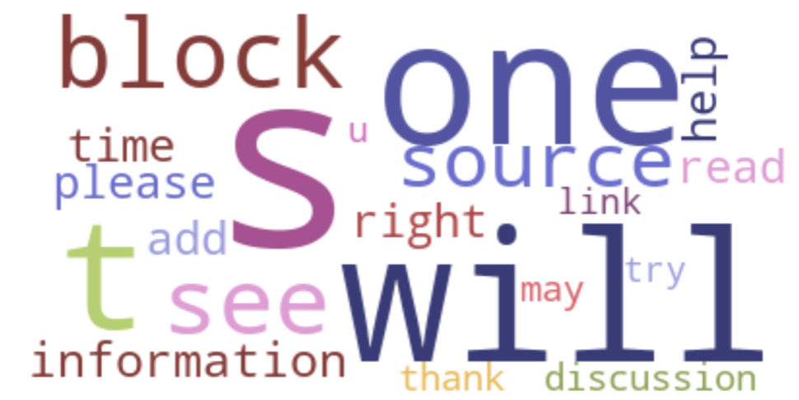
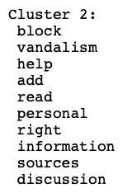
Topic Trends for Model with Features
Three clusters were determined to be optimal for CV7
Clusters did not indicate varying levels of toxicity.

Slide 20
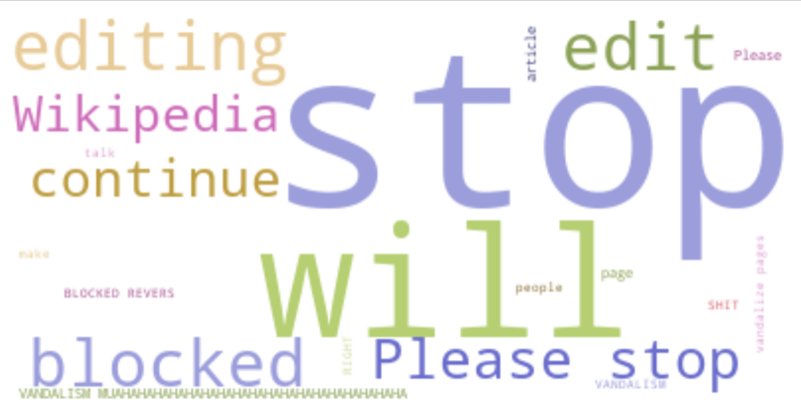
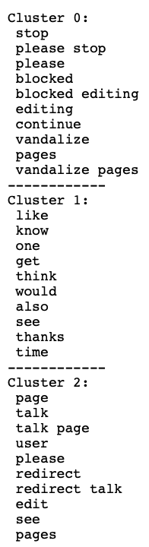
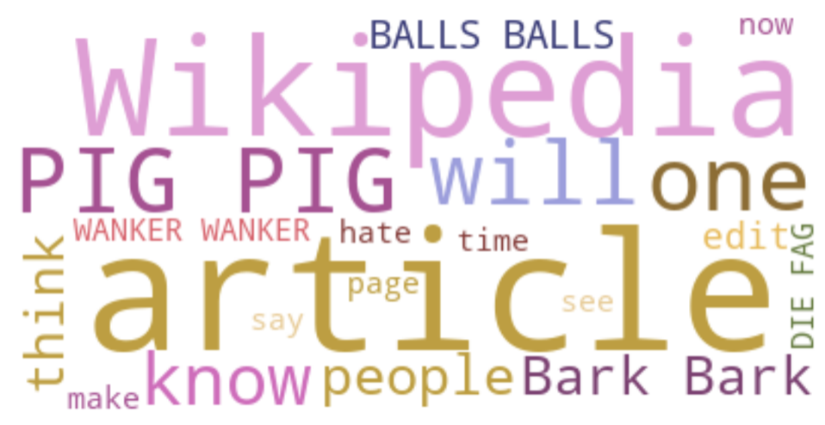
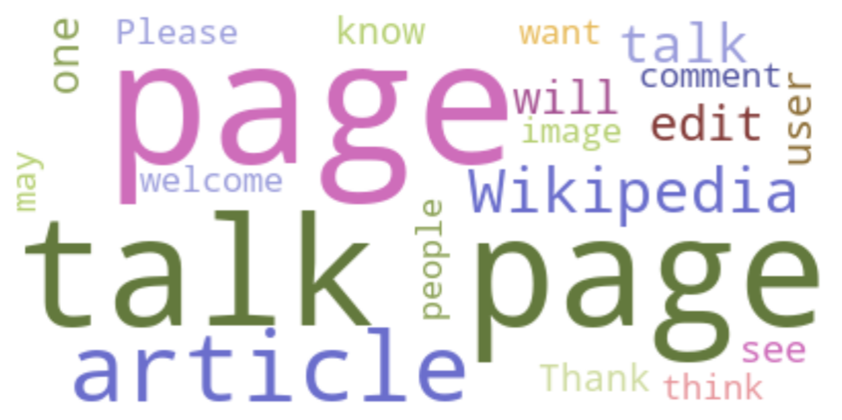
Topic Trends for Model without Features
Three clusters were determined to be optimal for CV4
Clusters did not indicate varying levels of toxicity.
Significantly better quality of features

Slide 21
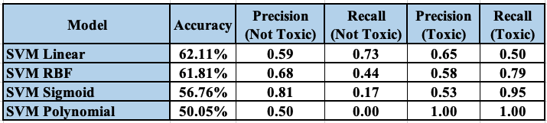
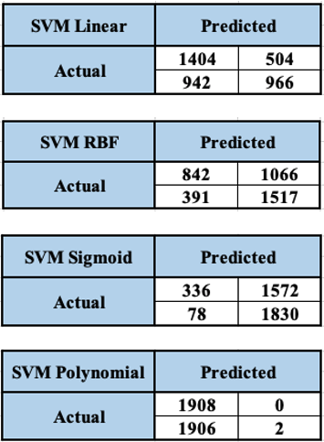
Support Vector Machines
Four Support Vector Machine Models trained on the Wikipedia Comments Corpus
Labels: Toxic and Not Toxic

Slide 22
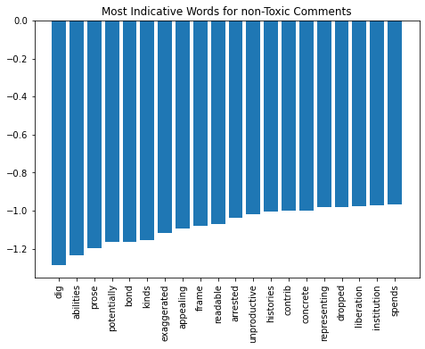
Support Vector Machines: Linear
Words like “dig,” “abilities,” “bond,” “kinds,” and “liberation” were helpful in distinguishing non-toxic comments from toxic ones.

Slide 23
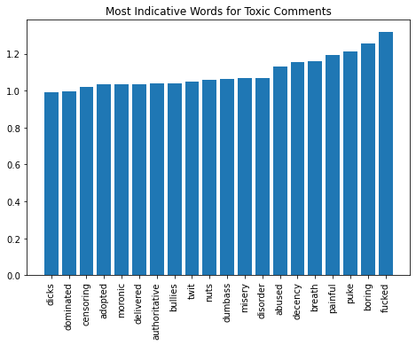
Support Vector Machines: Linear
Curse words along with words like “boring,” “misery,” and “painful” help in labeling comments as toxic.

Slide 24
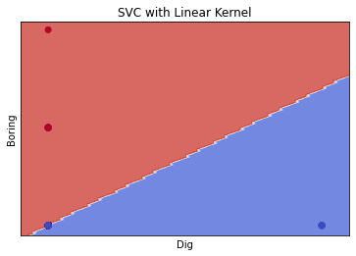
Support Vector Machines: Decision Boundaries

Slide 25
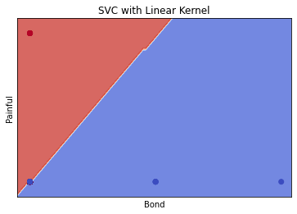
Support Vector Machines: Decision Boundaries

Slide 26
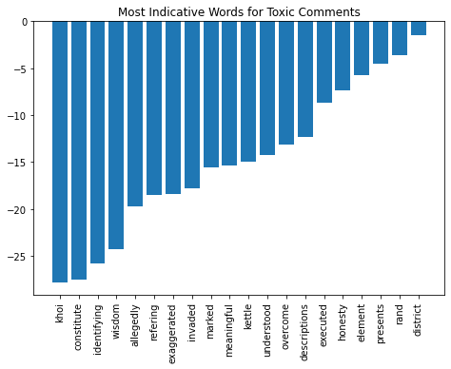
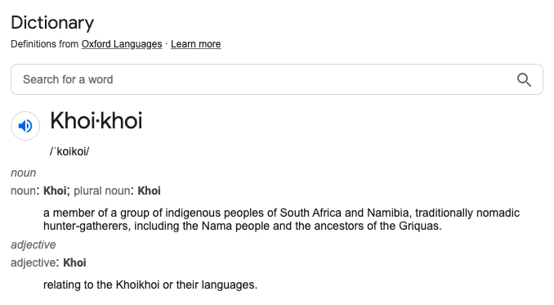
Challenges

Slide 27
Conclusions
Machine Learning Algorithms can identify patterns between toxic and non-toxic comments.
Machine Learning Algorithms can also help with measuring different levels of toxicity.
The task is non-trivial.

Slide 28
Sources
https://www.merriam-webster.com/dictionary/toxic
https://www.openweb.com/blog/toxic-online-comments-how-they-happen-and-how-to-stop-them
https://www.richardweechambers.com/toxicity-in-the-streaming-world-causes-effects-and-solutions/
https://l1ght.com/Toxicity_during_coronavirus_Report-L1ght.pdf
https://dataprot.net/statistics/cyberbullying-statistics/

